Slide 1
MySQL e LGPD
Vinicius M. Grippa Senior Support Engineer for MySQL/MongoDB
vinicius.grippa@percona.com

Slide 2
About Me
Support Engineer at Percona since 2017.
Working with MySQL for over six years.
Working with databases for over nine years.
Speaker at PL 2018 and meetups about MySQL/MongoDB.

Slide 3
Basic Principles
Minimum access
Isolate
Audit
Avoid spying
Default firewall

Slide 4
Agenda
SO/Cloud security
SSL
Password management
Audit plugin
Percona Server encryption features
MySQL 8 features (undo, redo encryption)
TDE
New caching_sha2_password
FIPS mode
Roles

Slide 5
OS/Cloud Security

Slide 6
OS/Cloud Security
Uninstall services that are not used
Do not run compilers
Firewalls
Block internet access
Disable remote root login
Use of SSH Key

Slide 7
OS/Cloud Security
Use of Amazon Virtual Private Cloud (VPC)
Use AWS Identity and Access Management (IAM) policies
Use security groups

Slide 8
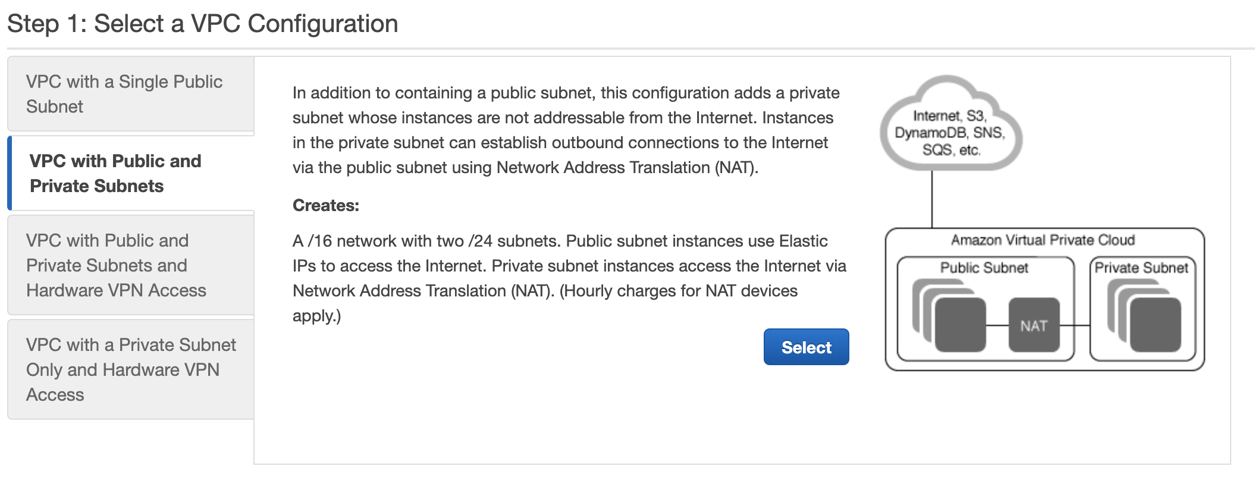
OS/Cloud Security

Slide 9
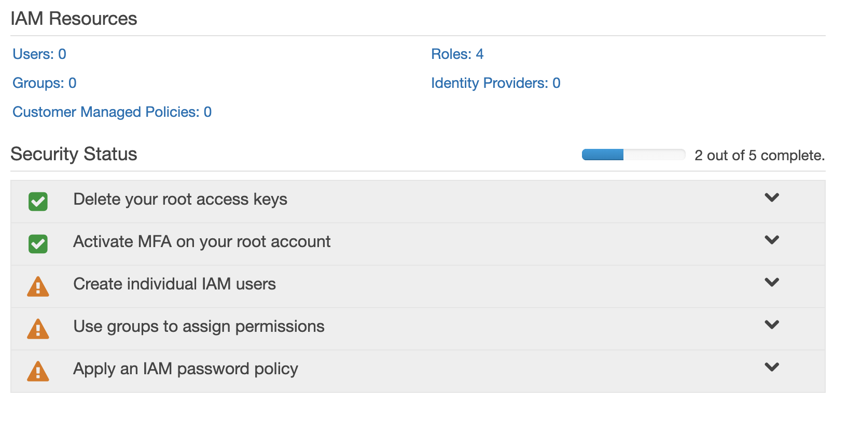
OS/Cloud Security

Slide 10
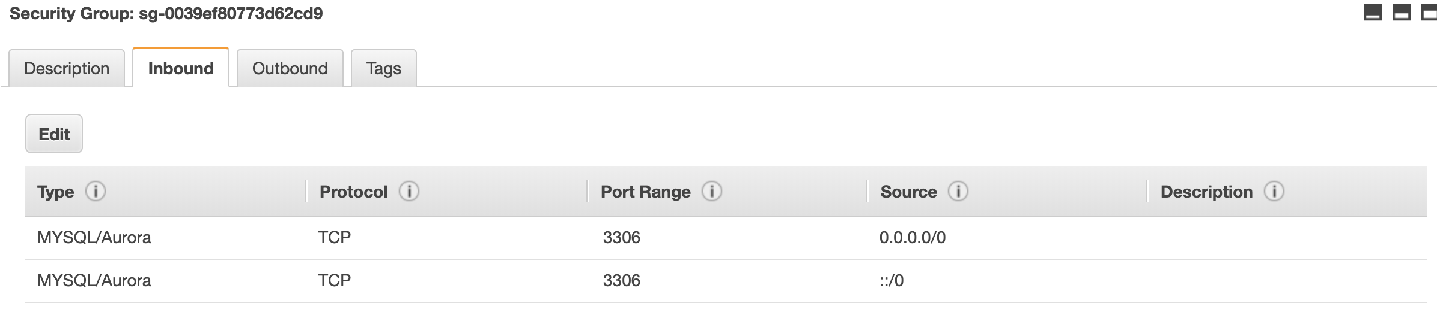
OS/Cloud Security

Slide 11
SSL

Slide 12
SSL
Move information over a network in a secure fashion
SSL provides an way to cryptograph the data
Default for MySQL 5.7 or higher
Certificates
MySQL 5.7
mysql_ssl_rsa_setup
MySQL 5.6
openssl
Notes:
SSL comes with a cost in Performance (around 10-20%)

Slide 13
SSL
mysql > show global variables like '%ssl%';
+---------------+-----------------+
| Variable_name | Value |
+---------------+-----------------+
| have_openssl | YES |
| have_ssl | YES |
| ssl_ca | ca.pem |
| ssl_capath | |
| ssl_cert | server-cert.pem |
| ssl_cipher | |
| ssl_crl | |
| ssl_crlpath | |
| ssl_key | server-key.pem |
+---------------+-----------------+
9 rows in set (0.03 sec)

Slide 14
SSL
mysql: root@localhost ((none)) GRANT ALL PRIVILEGES ON *.* TO 'ssluser'@'%' IDENTIFIED BY 'sekret' REQUIRE SSL;
Query OK, 0 rows affected, 1 warning (0.00 sec) Query OK, 0 rows affected (0.01 sec)
[root@node1 ~]# mysql -ussluser -psekret --ssl-cert=/var/lib/mysql/client-cert.pem --ssl-key=/var/lib/mysql/client-key.pem --ssl-ca=/var/lib/mysql/ca.pem -h 127.0.0.1 -P 3306 -e "\s"| grep SSL
mysql: [Warning] Using a password on the command line interface can be insecure.
SSL: Cipher in use is ECDHE-RSA-AES128-GCM-SHA256

Slide 15
SSL
It is also possible to set ssl-mode to ensure that all connections use SSL. This option is available only for client programs, not the server.
[client]
ssl-mode=required

Slide 16
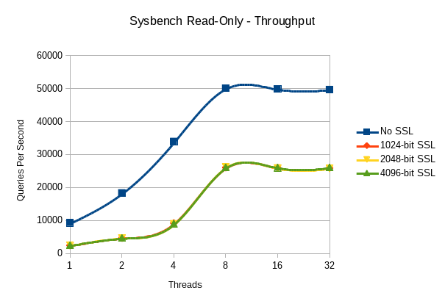
SSL

Slide 17
Password Management

Slide 18
Password Management
Password expiration
validate_password plugin

Slide 19
Password Expiration
MySQL enables database administrators to expire account passwords manually, and to establish a policy for automatic password expiration. Expiration policy can be established globally, and individual accounts can be set to either defer to the global policy or override the global policy with specific per-account behavior.

Slide 20
Password Expiration
Individual Accounts
mysql> create user test_expired_user@localhost identified by 'Sekr$K1et' PASSWORD EXPIRE INTERVAL 1 day;
Query OK, 0 rows affected (0.01 sec)
Globally
mysql> SET GLOBAL default_password_lifetime = 1;

Slide 21
Password Expiration
mysql: test_expired_user@localhost ((none)) > show databases;
ERROR 1820 (HY000): You must reset your password using ALTER USER statement before executing this statement.

Slide 22
validate_plugin
Its main purpose is to test passwords and improve security. It is possible to ensure the strength, length and required characters of the password.

Slide 23
validate_plugin - Installing
# Runtime
mysql: root@localhost ((none)) > INSTALL PLUGIN validate_password SONAME 'validate_password.so';
Query OK, 0 rows affected (0.07 sec)
# my.cnf
[mysqld]
plugin-load-add=validate_password.so

Slide 24
validate_plugin - Validate
mysql: root@localhost ((none)) > show global variables like '%plugin%';
+-------------------------------+--------------------------+
| Variable_name | Value |
+-------------------------------+--------------------------+
| default_authentication_plugin | mysql_native_password |
| plugin_dir | /usr/lib64/mysql/plugin/ |
+-------------------------------+--------------------------+
2 rows in set (0.00 sec)
mysql: root@localhost ((none)) > SELECT PLUGIN_NAME, PLUGIN_STATUS
FROM INFORMATION_SCHEMA.PLUGINS
WHERE PLUGIN_NAME LIKE 'validate%';
+-------------------+---------------+
| PLUGIN_NAME | PLUGIN_STATUS |
+-------------------+---------------+
| validate_password | ACTIVE |
+-------------------+---------------+
1 row in set (0.00 sec)

Slide 25
validate_plugin - Example
mysql: root@localhost ((none)) > set global validate_password_length = 6;
Query OK, 0 rows affected (0.00 sec)
mysql: root@localhost ((none)) > set global validate_password_policy=2;
Query OK, 0 rows affected (0.00 sec)
Notes:
0 or LOW
Length
1 or MEDIUM
Length; numeric, lowercase/uppercase, and special characters
2 or STRONG
Length; numeric, lowercase/uppercase, and special characters; dictionary file

Slide 26
validate_plugin - Example
mysql: root@localhost ((none)) > create user test_password@localhost identified by 'PasSw0Rd';
ERROR 1819 (HY000): Your password does not satisfy the current policy requirements
mysql: root@localhost ((none)) > create user test_password@localhost identified by 'PasSw0Rd12@';
Query OK, 0 rows affected (0.00 sec)

Slide 27
Audit Plugin

Slide 28
Audit Plugin
MySQL Enterprise – Paid
Percona Server (works with community version) – Free
It is different from general log
Filter by command / user / database

Slide 29
Audit Plugin - Installing
mysql > INSTALL PLUGIN audit_log SONAME 'audit_log.so';
Query OK, 0 rows affected (0.05 sec)
mysql > SELECT PLUGIN_NAME, PLUGIN_STATUS FROM INFORMATION_SCHEMA.PLUGINS WHERE PLUGIN_NAME LIKE 'audit%';
+-------------+---------------+
| PLUGIN_NAME | PLUGIN_STATUS |
+-------------+---------------+
| audit_log | ACTIVE |
+-------------+---------------+
1 row in set (0.00 sec)

Slide 30
Audit Plugin
[mysqld]
## Audit Logging ##
audit_log_policy=ALL
audit_log_format=JSON
audit_log_file=/var/log/mysql/audit.log
audit_log_rotate_on_size=1024M
audit_log_rotations=10

Slide 31
Audit Plugin
mysql: root@localhost ((none)) > show global variables like 'audit%';
+-----------------------------+--------------------------+
| Variable_name | Value |
+-----------------------------+--------------------------+
| audit_log_buffer_size | 1048576 |
| audit_log_exclude_accounts | |
| audit_log_exclude_commands | |
| audit_log_exclude_databases | |
| audit_log_file | /var/log/mysql/audit.log |
| audit_log_flush | OFF |
| audit_log_format | JSON |
| audit_log_handler | FILE |
| audit_log_include_accounts | |
| audit_log_include_commands | |
| audit_log_include_databases | |

Slide 32
Audit Plugin
mysql: root@localhost ((none)) > show global variables like 'audit%';
+-----------------------------+--------------------------+
| Variable_name | Value |
+-----------------------------+--------------------------+
| audit_log_policy | ALL |
| audit_log_rotate_on_size | 1073741824 |
| audit_log_rotations | 10 |
| audit_log_strategy | ASYNCHRONOUS |
| audit_log_syslog_facility | LOG_USER |
| audit_log_syslog_ident | percona-audit |
| audit_log_syslog_priority | LOG_INFO |
+-----------------------------+--------------------------+
18 rows in set (0.02 sec)

Slide 33
Percona Server Encryption Features

Slide 34
Percona Server Encryption
Percona server provides extra encryption:
encrypt_binlog
encrypt_tmp_files
innodb_encrypt_online_alter_logs
innodb_encrypt_tables – BETA quality
innodb_parallel_dblwr_encrypt – ALPHA quality
innodb_sys_tablespace_encrypt – ALPHA quality
innodb_temp_tablespace_encrypt – BETA quality

Slide 35
Percona Server Encryption
[mysqld]
# Binary Log Encryption
encrypt_binlog
master_verify_checksum = 1
binlog_checksum = 1
mysql: root@localhost ((none)) > show global variables like '%encrypt_binlog%';
+----------------+-------+
| Variable_name | Value |
+----------------+-------+
| encrypt_binlog | ON |
+----------------+-------+
1 row in set (0.00 sec)

Slide 36
Percona Server Encryption
mysql: root@localhost ((none)) > show global variables like '%encrypt%';
+----------------------------------+-------------+
| Variable_name | Value |
+----------------------------------+-------------+
| block_encryption_mode | aes-128-ecb |
| encrypt_binlog | ON |
| encrypt_tmp_files | OFF |
| innodb_encrypt_online_alter_logs | OFF |
| innodb_encrypt_tables | OFF |
| innodb_parallel_dblwr_encrypt | OFF |
| innodb_sys_tablespace_encrypt | OFF |
| innodb_temp_tablespace_encrypt | OFF |
+----------------------------------+-------------+
8 rows in set (0.00 sec)

Slide 37
MySQL 8 Features
(Undo, Redo Encryption)

Slide 38
MySQL 8 - (Undo, Redo Encryption)
MySQL 8 extends tablespace encryption feature to redo log and undo log.
It is necessary using one of the Keyring plugins.

Slide 39
MySQL 8 - (Undo, Redo Encryption)
The process is very straightforward, to enable the encryption on the redo log and the undo log:
mysql> set global innodb_undo_log_encrypt = 1;
Query OK, 0 rows affected (0.00 sec)
mysql> set global innodb_redo_log_encrypt = 1;
Query OK, 0 rows affected (0.00 sec)
mysql> show global variables like '%log_encrypt%';
+-------------------------+-------+
| Variable_name | Value |
+-------------------------+-------+
| innodb_redo_log_encrypt | ON |
| innodb_undo_log_encrypt | ON |
+-------------------------+-------+
2 rows in set (0.00 sec)

Slide 40
Transparent Data Encryption (TDE)

Slide 41
Transparent Data Encryption (TDE)
Enables data-at-rest encryption in the database.
Encryption and decryption occurs without any additional coding, data type or schema modifications.

Slide 42
Transparent Data Encryption (TDE)
[mysqld]
# TDE
early-plugin-load=keyring_file.so
keyring-file-data=/var/lib/mysql-keyring/keyring
mysql: root@localhost ((none)) > INSTALL PLUGIN keyring_udf SONAME 'keyring_udf.so';
Query OK, 0 rows affected (0.00 sec)
mysql: root@localhost ((none)) > SELECT PLUGIN_NAME, PLUGIN_STATUS
FROM INFORMATION_SCHEMA.PLUGINS
WHERE PLUGIN_NAME LIKE 'keyring%';
+--------------+---------------+
| PLUGIN_NAME | PLUGIN_STATUS |
+--------------+---------------+
| keyring_file | ACTIVE |
| keyring_udf | ACTIVE |
+--------------+---------

Slide 43
Transparent Data Encryption (TDE)
mysql: root@localhost ((none)) > SELECT keyring_key_generate('MyKey', 'AES', 32);
+------------------------------------------+
| keyring_key_generate('MyKey', 'AES', 32) |
+------------------------------------------+
| 1 |
+------------------------------------------+
1 row in set (0.00 sec)
mysql> CREATE TABLESPACE `amer_meeting1` ADD DATAFILE 'amer_meeting1.ibd' ENCRYPTION = 'Y' Engine=InnoDB;
Query OK, 0 rows affected (0.01 sec)
mysql: root@localhost (test) > CREATE TABLE t1 (a INT, b TEXT) TABLESPACE vgrippa ENCRYPTION='N';
ERROR 1478 (HY000): InnoDB: Tablespace `vgrippa` can contain only an ENCRYPTED tables.
mysql: root@localhost (test) > CREATE TABLE t1 (a INT, b TEXT) TABLESPACE vgrippa ENCRYPTION='Y';
Query OK, 0 rows affected (0.02 sec)

Slide 44
Transparent Data Encryption (TDE)
A flag field in the INFORMATION_SCHEMA.INNODB_SYS_TABLESPACES has bit number 13 set if tablespace is encrypted.
mysql: root@localhost (test) > SELECT space, name, flag, (flag & 8192) != 0 AS encrypted FROM INFORMATION_SCHEMA.INNODB_SYS_TABLESPACES WHERE name in ('vgrippa');
+-------+---------+-------+-----------+
| space | name | flag | encrypted |
+-------+---------+-------+-----------+
| 156 | vgrippa | 10240 | 1 |
+-------+---------+-------+-----------+
1 row in set (0.00 sec)

Slide 45
caching_sha2_password

Slide 46
caching_sha2_password
MySQL provides two authentication plugins that implement SHA-256 hashing for user account passwords:
sha256_password: Implements basic SHA-256 authentication
caching_sha2_password: Implements SHA-256 authentication (like sha256_password), but uses caching on the server side for better performance and has additional features for wider applicability. (In MySQL 5.7, caching_sha2_password is implemented only on the client)
Note: In MySQL 8.0, caching_sha2_password is the default authentication plugin rather than mysql_native_password.
Notes:
mysql_native_password relies on SHA1 algorithm
Rainbow tables can be used to perform a brute force attack

Slide 47
caching_sha2_password
mysql: root@localhost ((none)) > grant all privileges on *.* to vgrippa@localhost identified by 'teste';
Query OK, 0 rows affected, 1 warning (0.00 sec)
mysql: root@localhost ((none)) > grant all privileges on *.* to vgrippa1@localhost identified by 'teste';
Query OK, 0 rows affected, 1 warning (0.00 sec)

Slide 48
caching_sha2_password
mysql: root@localhost ((none)) > select user, host, plugin, authentication_string from mysql.user where user like 'vgrippa%';
+----------+-----------+-----------------------+-------------------------------------------+
| user | host | plugin | authentication_string |
+----------+-----------+-----------------------+-------------------------------------------+
| vgrippa | localhost | mysql_native_password | *A00D6EEF76EC509DB66358D2E6685F8FF7A4C3DD |
| vgrippa1 | localhost | mysql_native_password | *A00D6EEF76EC509DB66358D2E6685F8FF7A4C3DD |
+----------+-----------+-----------------------+-------------------------------------------+
2 rows in set (0.00 sec)
Notes:
To avoid that, salt should be used. Salt is basically a random number that is used as one of the inputs to cryptographic hash functions used to transform user passwords. Since salt is random and different for each execution, even if two users use the same passwords, the end result of transformation would look very different

Slide 49
Example
# MySQL 8 [mysqld] default_authentication_plugin=caching_sha2_password
mysql> CREATE USER 'sha2user'@'localhost' IDENTIFIED WITH caching_sha2_password BY 'password';
Query OK, 0 rows affected (0.06 sec)
mysql> select user,host, plugin from mysql.user where user like 'sha2user%';
+----------+-----------+-----------------------+
| user | host | plugin |
+----------+-----------+-----------------------+
| sha2user | localhost | caching_sha2_password |
+----------+-----------+-----------------------+
1 row in set (0.00 sec)

Slide 50
Example
mysql: root@localhost ((none)) > create user vgrippa@localhost identified by 'teste';
Query OK, 0 rows affected (0.01 sec)
mysql: root@localhost ((none)) > create user vgrippa1@localhost identified by 'teste';
Query OK, 0 rows affected (0.01 sec)

Slide 51
Example
mysql: root@localhost ((none)) > select user, host, plugin, authentication_string from mysql.user where user like 'vgrippa%';
+----------+-----------+-----------------------+------------------------------------------------------------------------+
| user | host | plugin | authentication_string |
+----------+-----------+-----------------------+------------------------------------------------------------------------+
| vgrippa | localhost | caching_sha2_password | $A$005$)8?=V_"J75FFq |jUVMUZmnZ1t8aSybB4AISoj1MXdlseI0rQay6bGGlne8 |
| vgrippa1 | localhost | caching_sha2_password | $A$005$zEZ;bEmj[hq1T\!LFtqZzAB0hacxgwNfHM/gL6gBFHqY1wuozW2NO4Gj9958 |
+----------+-----------+-----------------------+------------------------------------------------------------------------+
2 rows in set (0.01 sec)

Slide 52
FIPS Mode

Slide 53
FIPS
MySQL supports FIPS mode, if compiled using OpenSSL, and an OpenSSL library and FIPS Object Module are available at runtime.
FIPS mode on the server side applies to cryptographic operations performed by the server. This includes replication (master/slave and Group Replication) and X Plugin, which run within the server. FIPS mode also applies to attempts by clients to connect to the server.

Slide 54
Example
mysql> show global variables like '%fips%';
+---------------+-------+
| Variable_name | Value |
+---------------+-------+
| ssl_fips_mode | ON |
+---------------+-------+
1 row in set (0.01 sec)
mysql> set global ssl_fips_mode=1;
Query OK, 0 rows affected (0.06 sec)

Slide 55
Example
mysql> select md5('a');
+----------------------------------+
| md5('a') |
+----------------------------------+
| 00000000000000000000000000000000 |
+----------------------------------+
1 row in set, 1 warning (0.00 sec)

Slide 56
Example
mysql> show warnings;
+---------+-------+------------------------------------------------------------------------+
| Level | Code | Message |
+---------+-------+------------------------------------------------------------------------+
| Warning | 11272 | SSL fips mode error: FIPS mode ON/STRICT: MD5 digest is not supported. |
+---------+-------+------------------------------------------------------------------------+
1 row in set (0.00 sec)

Slide 57
Example
mysql> select sha2('a', 256);
+------------------------------------------------------------------+
| sha2('a', 256) |
+------------------------------------------------------------------+
| ca978112ca1bbdcafac231b39a23dc4da786eff8147c4e72b9807785afee48bb |
+------------------------------------------------------------------+
1 row in set (0.00 sec)

Slide 58
Roles

Slide 59
Roles
MySQL 8 comes with Roles feature. A role is a named collection of privileges. Like user accounts, roles can have privileges granted to and revoked from them.

Slide 60
Roles
mysql> create role app_read;
Query OK, 0 rows affected (0.03 sec)
mysql> grant select on *.* to app_read;
Query OK, 0 rows affected (0.04 sec)

Slide 61
Roles
mysql> select * from app_db.joinit;
ERROR 1142 (42000): SELECT command denied to user 'test_role'@'localhost' for table 'joinit'
mysql> SELECT CURRENT_ROLE();
+----------------+
| CURRENT_ROLE() |
+----------------+
| NONE |
+----------------+
1 row in set (0.00 sec)

Slide 62
Roles
mysql> SET ROLE all;
Query OK, 0 rows affected (0.00 sec)
mysql> SELECT CURRENT_ROLE();
+-------------------------------------------------------+
| CURRENT_ROLE() |
+-------------------------------------------------------+
| `app_read`@`%`,`app_write`@`%`,`app_read`@`localhost` |
+-------------------------------------------------------+
1 row in set (0.00 sec)
mysql> select * from app_db.joinit;

Slide 63
Roles
It is possible to use activate_all_roles_on_login to activate all roles granted to each account at login time.

Slide 64
References
# SO/Cloud security
https://docs.aws.amazon.com/AmazonRDS/latest/UserGuide/UsingWithRDS.html
https://docs.aws.amazon.com/vpc/latest/userguide/VPC_SecurityGroups.html
# Audit log
https://www.percona.com/blog/2015/09/10/percona-server-audit-log-plugin-best-practices/
#caching_sha2_password
https://dev.mysql.com/doc/refman/5.7/en/caching-sha2-pluggable-authentication.html
# SSL
https://www.percona.com/blog/2013/06/22/setting-up-mysql-ssl-and-secure-connections/#setup
https://www.percona.com/blog/2013/10/10/mysql-ssl-performance-overhead/
# TDE https://www.percona.com/doc/percona-server/LATEST/management/data_at_rest_encryption.html
https://www.percona.com/doc/percona-server/LATEST/management/data_at_rest_encryption.html#usage
https://dev.mysql.com/doc/refman/5.7/en/keyring-file-plugin.html
# Roles
https://dev.mysql.com/doc/refman/8.0/en/server-system-variables.html#sysvar_activate_all_roles_on_login
https://dev.mysql.com/doc/refman/8.0/en/roles.html
# Password management
https://dev.mysql.com/doc/refman/5.7/en/password-management.html
https://dev.mysql.com/doc/refman/5.7/en/validate-password-installation.html
https://dev.mysql.com/doc/refman/5.7/en/validate-password-options-variables.html
# FIPS
https://dev.mysql.com/doc/refman/8.0/en/fips-mode.html
# Percona Server 8.0 Alpha release
https://www.percona.com/blog/2018/09/27/announcement-alpha-build-of-percona-server-8-0/
# MySQL 8 redo and undo encryption
https://dev.mysql.com/doc/refman/8.0/en/innodb-tablespace-encryption.html#innodb-tablespace-encryption-about

Slide 65
Any Questions?

Slide 66
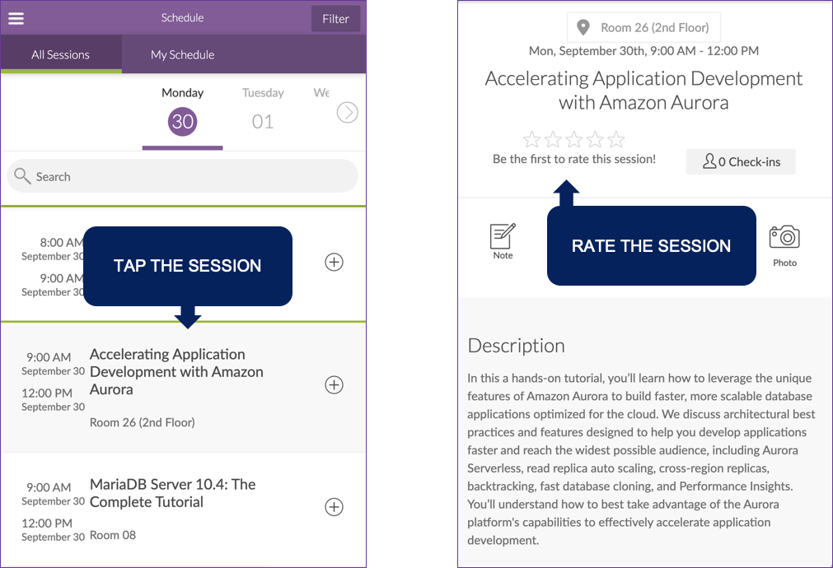
Rate My Session

Slide 67

We’re Hiring!
Percona’s open source database experts are true superheroes, improving database performance for customers across the globe.
Our staff live in nearly 30 different countries around the world, and most work remotely from home.
Discover what it means to have a Percona career with the smartest people in the database performance industries, solving the most challenging problems our customers come across.

